Slide 1
Core Ops QE
Quality Engineering Upskill Plan
09/21/2016
TCS Confidential

Slide 2




Test Automation
Entry Criteria :
Quality Engineer Beginner level : Should have performed Quality Assurance services for 2 years with exposure to waterfall and agile methodologies.
Quality Engineer Intermediate level : All trainings and self study of Quality Engineer Beginner level completed successfully.
Quality Engineer Expert level : All trainings (both Session and Hands On) and self study of Quality Engineer Intermediate level completed successfully.
Beginner
Intermediate
9 hours
Fundamentals of Test Automation operations
- Automation feasibility, Automation estimation and ROI calculation, Automation suite maintenance, Reusable automation framework
→ Tools Sets: QTP, UFT, Selenium Web Drivers, DVO, SOPA UI & HP ALM, Custom tools development using .Net & VBA
→ Selenium - Lesson 2
→ UFT - Lesson 2
Sikuli - Lesson 2
→ Test Automation Overview
→ Test Automation Basics - Types of test automation, Automation framework, Automation design script, data and integration, Basic API and scripting and Automation test documentation
→Introduction to Selenium
→ Introduction to UFT
→ Introduction to DVO
→ Introduction to Sikuli
14 hours
Training hours : 38
Study hours : 25
Total hours : 58
Training hours : 9
Study hours : 9
Total hours : 18
→ Test Automation – 1 & 2
→ Selenium
→ UFT
→ DVO
→ Sikuli
24 hours
Total Time required to upskill to Quality Engineer - Beginner Level in Service Virtualization : 18 hours (~ 2 person days)
Total Time required to upskill to Quality Engineer - Intermediate Level in Service Virtualization : 63 hours (~ 7 person days)

Slide 3



Service Virtualization
Entry Criteria :
Quality Engineer Beginner level : Should have performed Quality Assurance services for 2 years with exposure to waterfall and agile methodologies.
Quality Engineer Intermediate level : All trainings and self study of Quality Engineer Beginner level completed successfully.
Quality Engineer Expert level : All trainings (both Session and Hands On) and self study of Quality Engineer Intermediate level completed successfully.
Intermediate
Beginner
Intermediate
→ Service Virtualization Overview
→ Training in standard protocols - Soap XML, HTML, MQ/JMS, JDBC
→ Training on Web Service & Rest Services
→ Different service virtualization tools and virtual service design technique - CA DevTest
→ CA DevTest Overview and Architecture
→ Registry, Services and Workstation, Coordinator & Simulators, VSE (Virtual Service Engine)
→ How to access registry
→ Creating VSI & VSM concepts
→ Creating Virtual Service using Recording method, from WSDL, using Request/Response pairs, Server Console and Troubleshooting Techniques
→ Major Components of Virtual Service - VSI (Virtual Service Image), VSM (Virtual Service Model), Project Config, Main & Sub-Process Test Cases, Suites/ AuditDocs / Staging Documents
→ Testing Virtual Services
→ Externalized Data & ALM Trigger
→ Virtualization of different types of services/protocols e.g. Web services, Rest, JDBC, JMS
→ Design of virtual services requiring custom protocol handlers
→ Using custom scripting in virtual service
3.2 hours
11 hours
Training hours : 3
Study hours : 9
Total hours : 12
Training hours : 14
Study hours : 9
Total hours : 23
Total Time required to upskill to Quality Engineer - Beginner Level in Service Virtualization : 12 hours (~ 1.3 person days)
Total Time required to upskill to Quality Engineer - Intermediate Level in Service Virtualization : 23 hours (~ 2.5 person days)
→ Service Virtualization from scratch
→ Modifying/ Updating Virtualization using CA DevTest
3 hours

Slide 4





DevOps
Entry Criteria :
Quality Engineer Beginner level : Should have performed Quality Assurance services for 2 years with exposure to waterfall and agile methodologies.
Quality Engineer Intermediate level : All trainings and self study of Quality Engineer Beginner level completed successfully.
Quality Engineer Expert level : All trainings (both Session and Hands On) and self study of Quality Engineer Intermediate level completed successfully.
Beginner
Intermediate
10.95 hours
→ Version Control Concepts and Tools – Creating projects and GIT concepts
→ Build Process and Tools - POM, Repositories, Dependencies and Manifests
→ Code Quality Analysis Concepts and tools – SonarQube Installation, setup, Analyzing Source code and reporting
→ Artifact Repository Management concepts and tools – Nexus snapshot, deployment, staging release, Create SVN tags, Stage and deploy the artifacts
→ Continuous Integration session 1 – Jenkins Installation, Jenkins ALM QTP setup and integration
→ Continuous Integration session 2 - Advanced Jenkins integration and deployment concepts
→ Automated Deployment - Advanced Udeploy concepts
→ Database Configuration management – Liquibase property files setup and advanced concepts
→ Unit Testing concepts – Creation of JUnit Unit test cases and exception handling
→ Overview of SDLC processes
→ Overview of DevOps
→ Version Control Concepts and Tools - GIT, SVN, TFS
→ Build Process and Tools - Maven, ANT
→ Code Quality Analysis Concepts and tools - SonarQube, Fortify
→ Artifact Repository Management concepts and tools – Nexus
→ Continuous Integration concepts and tools – Jenkins
→ Automated Deployment concepts and tools – Udeploy
→ Database Configuration management concepts and tools – Liquibase
→ Unit Testing concepts - Junit and Cucumber
27.15 hours
Training hours : 11
Study hours : 9
Total hours : 20
Total Time required to upskill to Quality Engineer - Beginner Level in DevOps : 20 hours (~ 2 person days)
Total Time required to upskill to Quality Engineer - Intermediate Level in Service Virtualization : 63.5 hours (~ 7 person days)
→ Version Control – GIT Lab
→ Build Process - Maven
→ Code Quality Analysis – SonarQube
→ Artifact Repository Management – Nexus
→ Continuous Integration – Jenkins
→ Automated Deployment - UDeploy
11.5 hours
Training hours : 38.5
Study hours : 25
Total hours : 63.5
Notes:
Assuming that 1 PD = 9 hours

Slide 5
QA to QE Upskill Schedule
Training Type | Test Automation |  |  | Service Virtualization |  |  | DevOps
 | Beginner | Intermediate | Expert | Beginner | Intermediate | Expert | Beginner | Intermediate | Expert
Session/Demo | 9 | 14 | - | 3 | 11 | - | 11 | 27 | -
Hands On/Assignment | - | 24 | - | - | 3 | - | - | 11.5 | -
Self Study | 9 | 25 | - | 9 | 9 | - | 9 | 25 | -
Field Experience | - | - | 6 months | - | - | 1 month | - | - | 6 months
Total(in PHs) | 18 | 63 | 6 months | 12 | 23 |  | 20 | 63.5
In PDs | 2 | 7 | 132 | 1.3 | 2.5 | 22 | 2.2 | 7 | 132
Total Upskill time from None to Expert | 142 days = 6.4 months |  |  | 25.8 days = 1.2 month |  |  | 141 days = 6.4 months
Notes:
Assumption : 1 Pd = 9 hrs
Field Experience : Actual QE implementation in the particular stream

Slide 6
QA to QE – Current State and Transformation Focus
Current state QE resources who are atleast Intermediate level in one of the three streams
QE Beginner as of September 2016
ASG | Test Automation |  | Service Virtualization |  | DevOps
 | Intermediate | Expert | Intermediate | Expert | Intermediate | Expert
CCP | 10 | 1 | 1 | - | 4 | -
Claims QA | 7 | 1 | 3 | - | - | -
SO | 3 | 2 | 3 | 1 | - | -
VBS | 15 | 2 | 8 | 1 | 7 | -
TSG | 3 | 3 | 4 | 2 | 4 | 1
Grand Total | 38 | 9 | 19 | 4 | 15 | 1
QEs as of Sep 2016 : 86
QA to QE transformation progression happens through focus on upskilling the resources in the above categories to QE - Intermediate level
QE Beginner as of September 2016
Pure QA with no exposure to QE as of September 2016
ASG | Test Automation | Service Virtualization | DevOps
CCP | 28 | 5 | 4
Claims QA | 34 | 19 | 8
NA | 3 | - | -
SO | 21 | 15 | 2
VBS | 69 | 33 | 17
Grand Total | 155 | 72 | 31
ASG | Total
CCP | 29
Claims QA | 71
SO | 9
VBS | 10
Grand Total | 119

Slide 7
Additional References

Slide 8
Quality Engineer : Competency Scale
Beginner
Intermediate
Expert
Test Automation
  Awareness on any/all of the following Test Automation concepts:
  Overall automation Testing concepts, process and methodology
  Types of test automation ,Automation frameworks
  Automation tools - HP QTP or Selenium etc.
  Hands on experience in any/all of the following :
Feasibility analysis, automation estimation and ROI calculation
Test automation design, scripts development and troubleshooting
Creation of automation regression suite in any technology - Mainframe application, Web based application, client/server application, packaged application
Performed one or more test automation with fair amount of working knowledge on any/all of the following :
Standard automation tools and open source tools
Automation tools and frameworks like RAFT, SCEGEN, BVT, Testify, Test coverage Analyzer, Musketeers etc.
Tool evaluation , feasibility study, strategy preparation
Service Virtualization
  Awareness on any/all of the following virtualization concepts:
Basic concepts of service virtualization and it’s benefits
Standard protocol
Soap XML, HTML, MQ/JMS, JDBC
Web services, Rest services, PL /SQL
EAI concept and middleware products from Vendors like TIBCO, Oracle, IBM etc.
  Hands on experience in any/all of the following :
Tools implementation, configuration and virtualization of different types of services/protocols e.g. Web services, Rest, JDBC, JMS
Design of a virtual service and adoption of best practices on deployment and hosting of virtual services.
Performed one or more service virtualizations with fair amount of working knowledge on any/all of the following :
Guidelines and best processes for service virtualization implementation
Customize existing virtualization for reuse
DevOps
  Awareness on the DevOps concepts:
Concepts of DevOps
DevOps culture
Lifecycle
DevOps tools
  Hands on experience in any/all of the following :
Hands-on experience in any of the tools for continuous build , validation monitoring and feedback, Source Code Management, Continuous Integration, Build Management, Artifact Management and Deployment
Performed one or more DevOps implementation with fair amount of working knowledge on any/all of the following :
Participated in bringing culture shift within projects through DevOps adoption
Establishing tools & techniques for DevOps
Familiar with Tools across different stages in Project lifecycle.

Slide 9
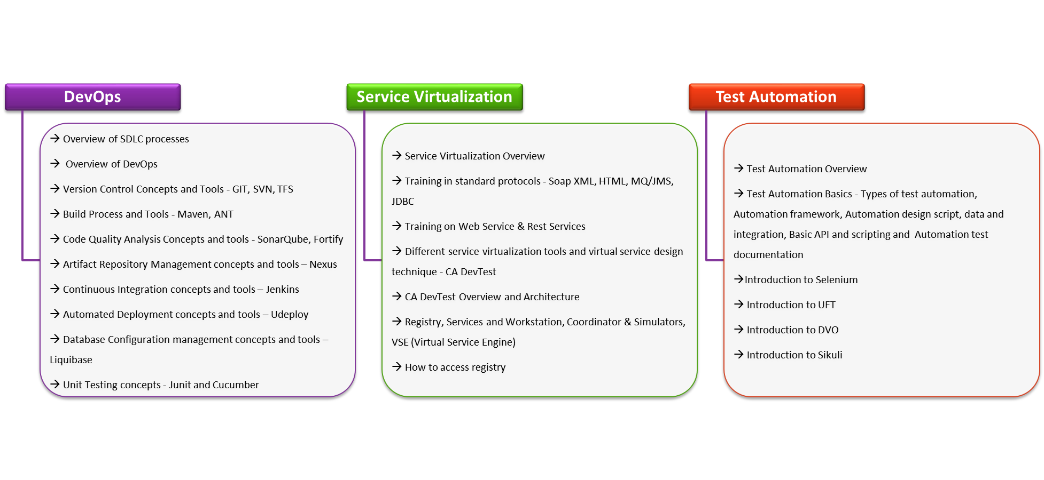
QE - Beginner Planner
Entry criteria for Quality Engineer Beginner level : Should have performed Quality Assurance services for 2 years with exposure to waterfall and agile methodologies.
10.95 hours
3.2 hours
9 hours
Total Time required to upskill to Quality Engineer - E0 Level, across DevOps, Service Virtualization and Test Automation : 23.15 hours (~ 2.5 person days)
Notes:
Assuming that 1 PD = 9 hours

Slide 10
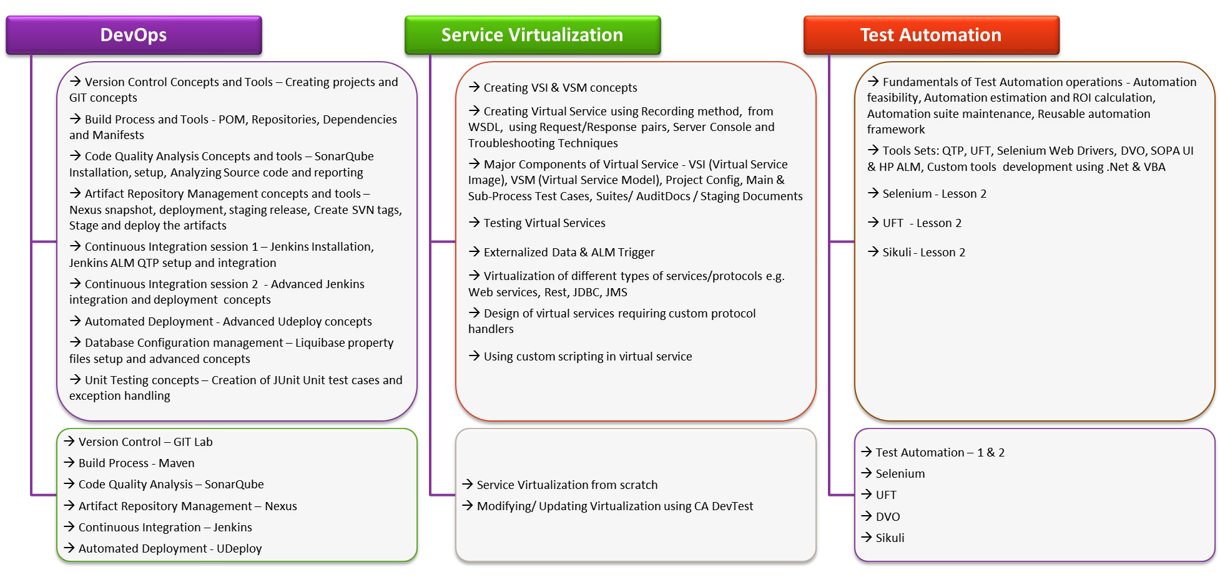

QE – Intermediate Planner
Entry criteria for Quality Engineer Intermediate level : All trainings of Quality Engineer Beginner level completed successfully.
27.15 hours
11 hours
14 hours
11.5 hours
3 hours
24 hours
Total Time required to upskill to Quality Engineer Beginner to Intermediate Level, across DevOps, Service Virtualization and Test Automation : 90.65 hours (~ 10 person days)
Notes:
Assuming that 1 PD = 9 hours

